Slide 1
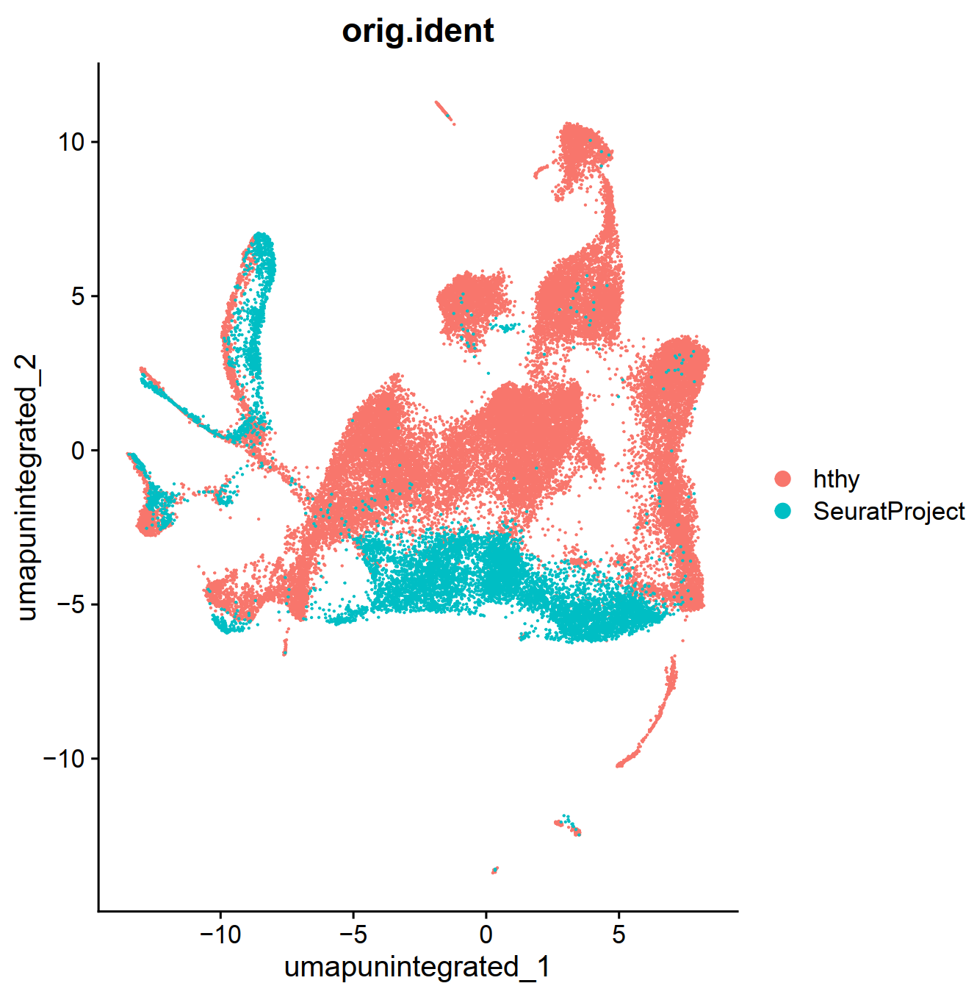
Merged but without integration

Slide 2
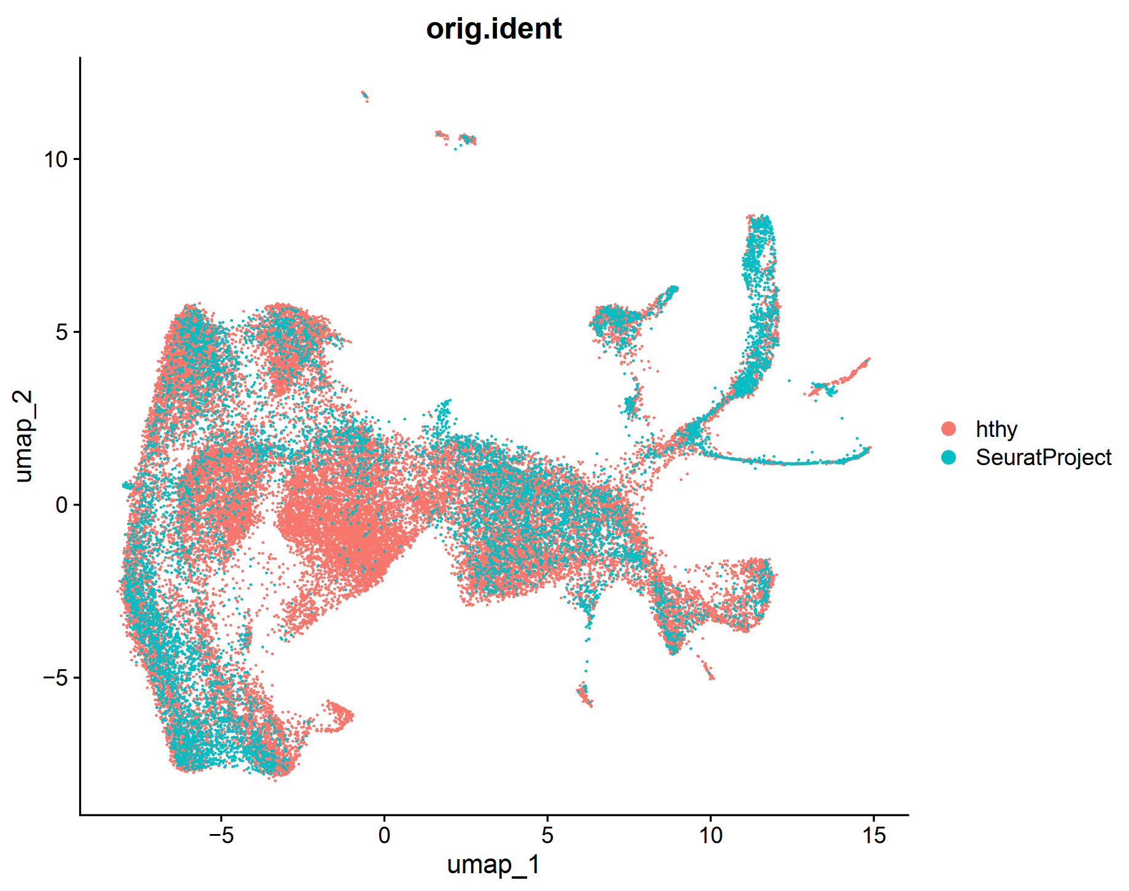
Merged, integrated by live vs fixed

Slide 3
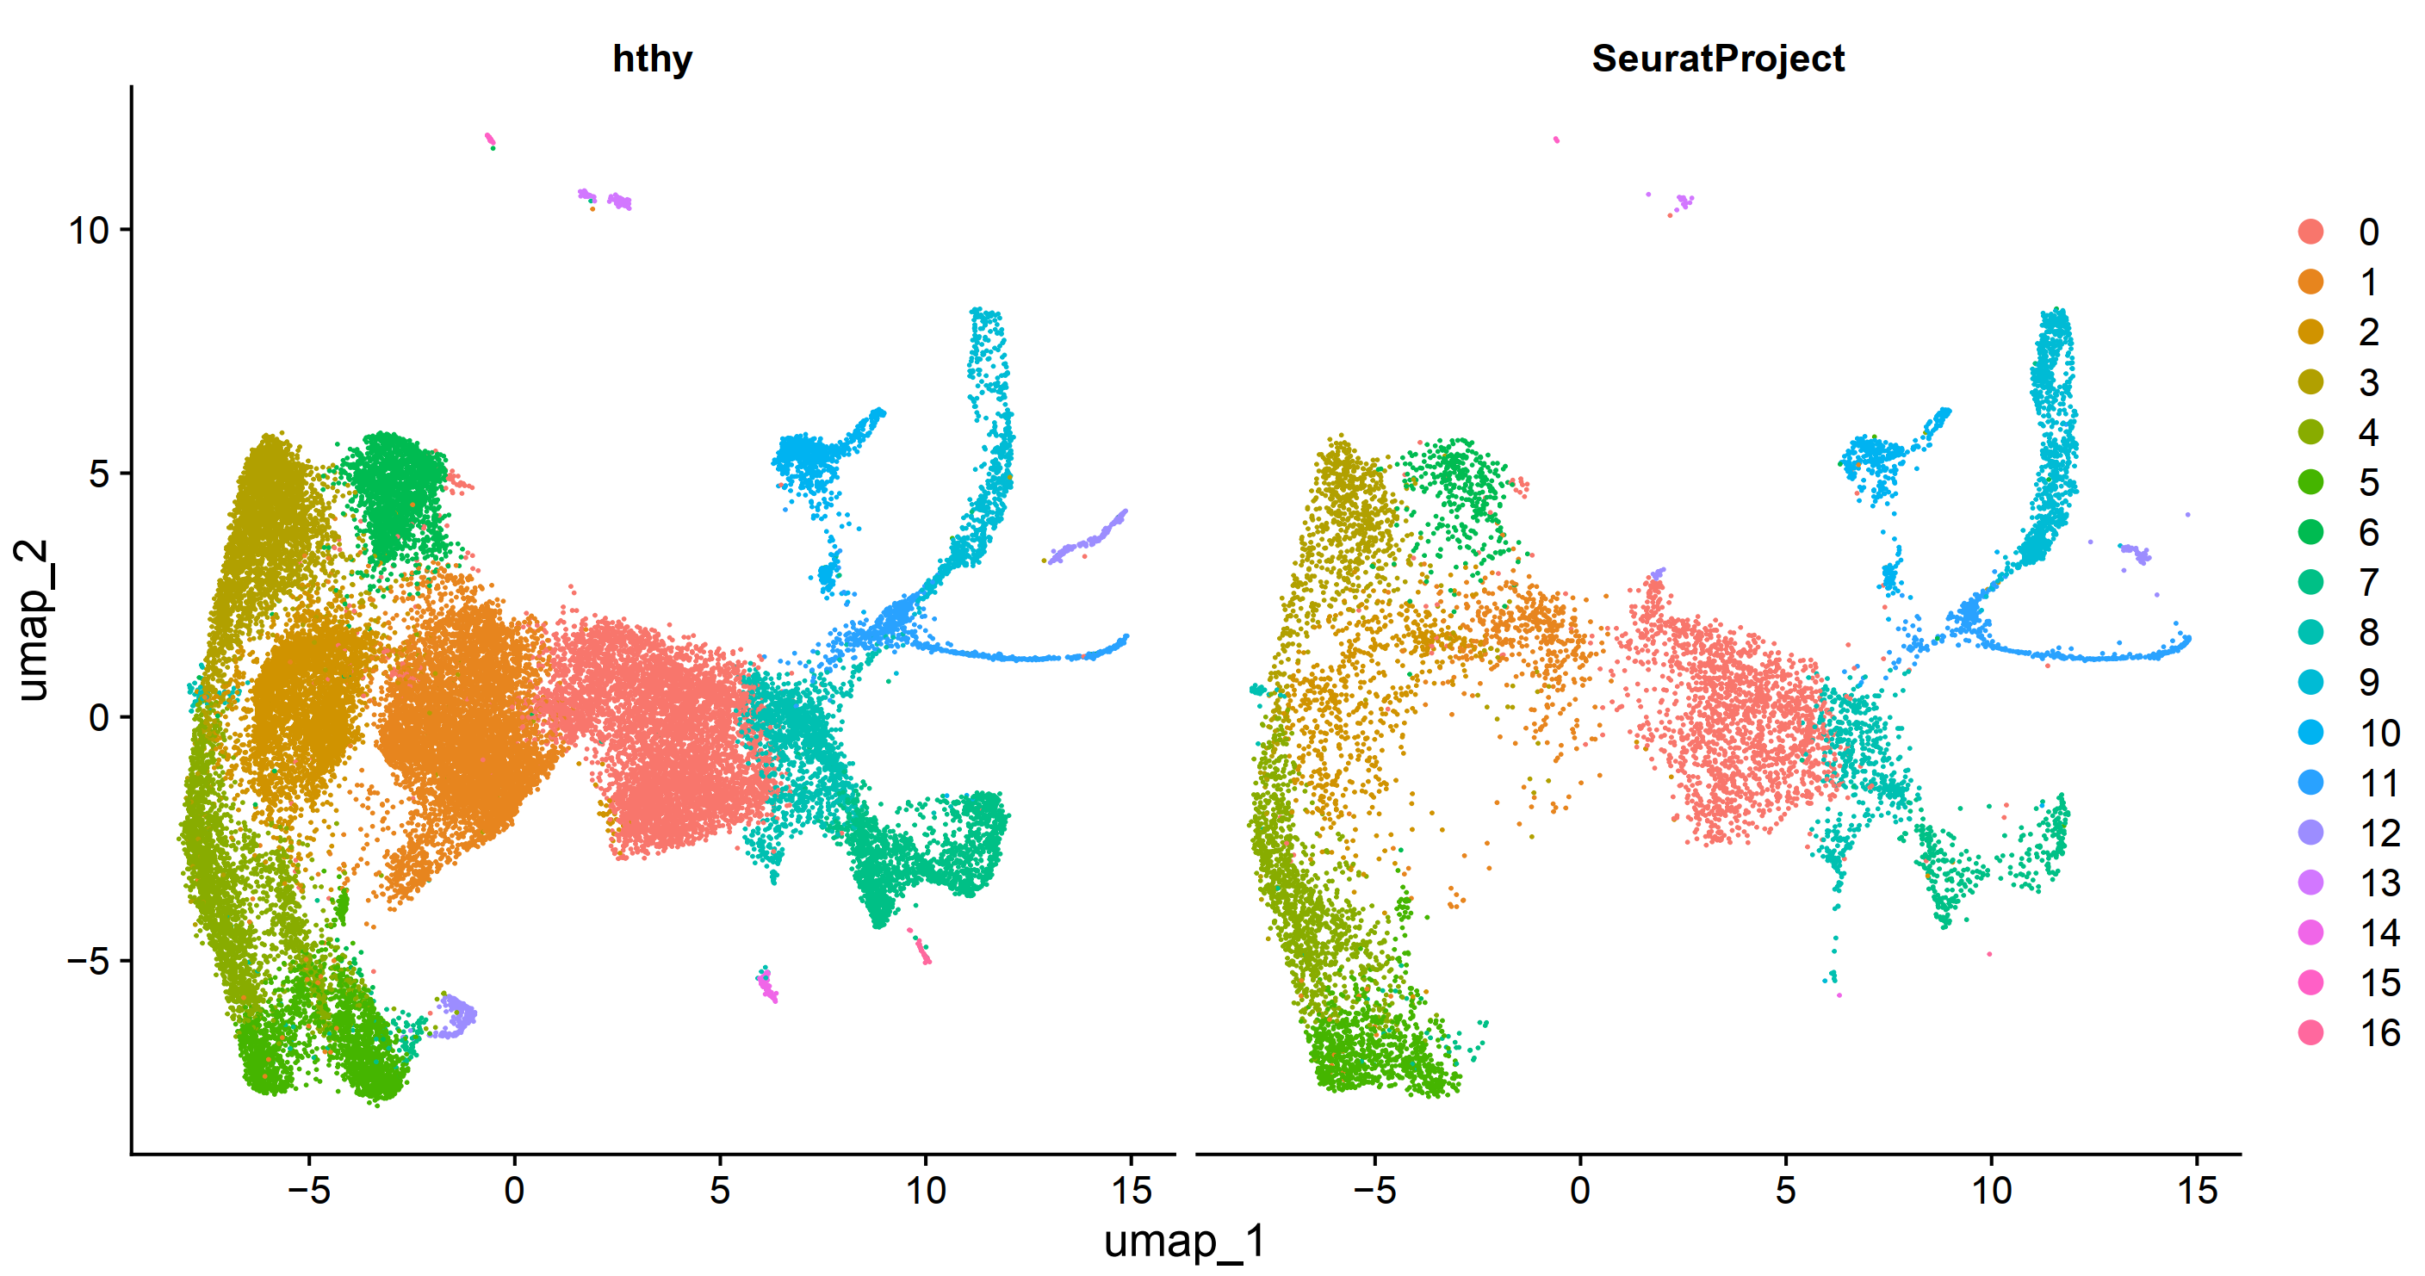
Integrated, split by fixed vs live

Slide 4
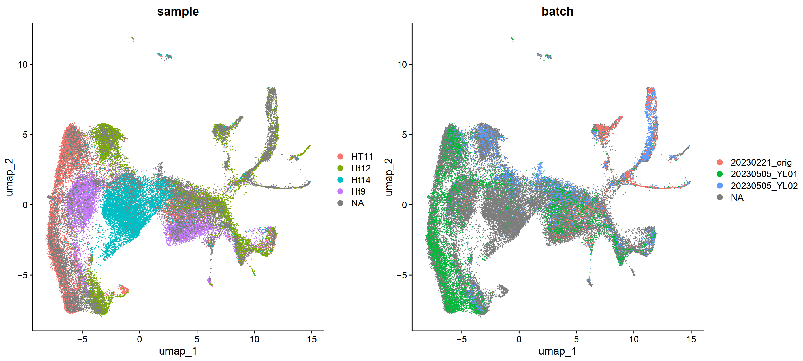
Integrated, split by fixed vs live, group by sample

Slide 5
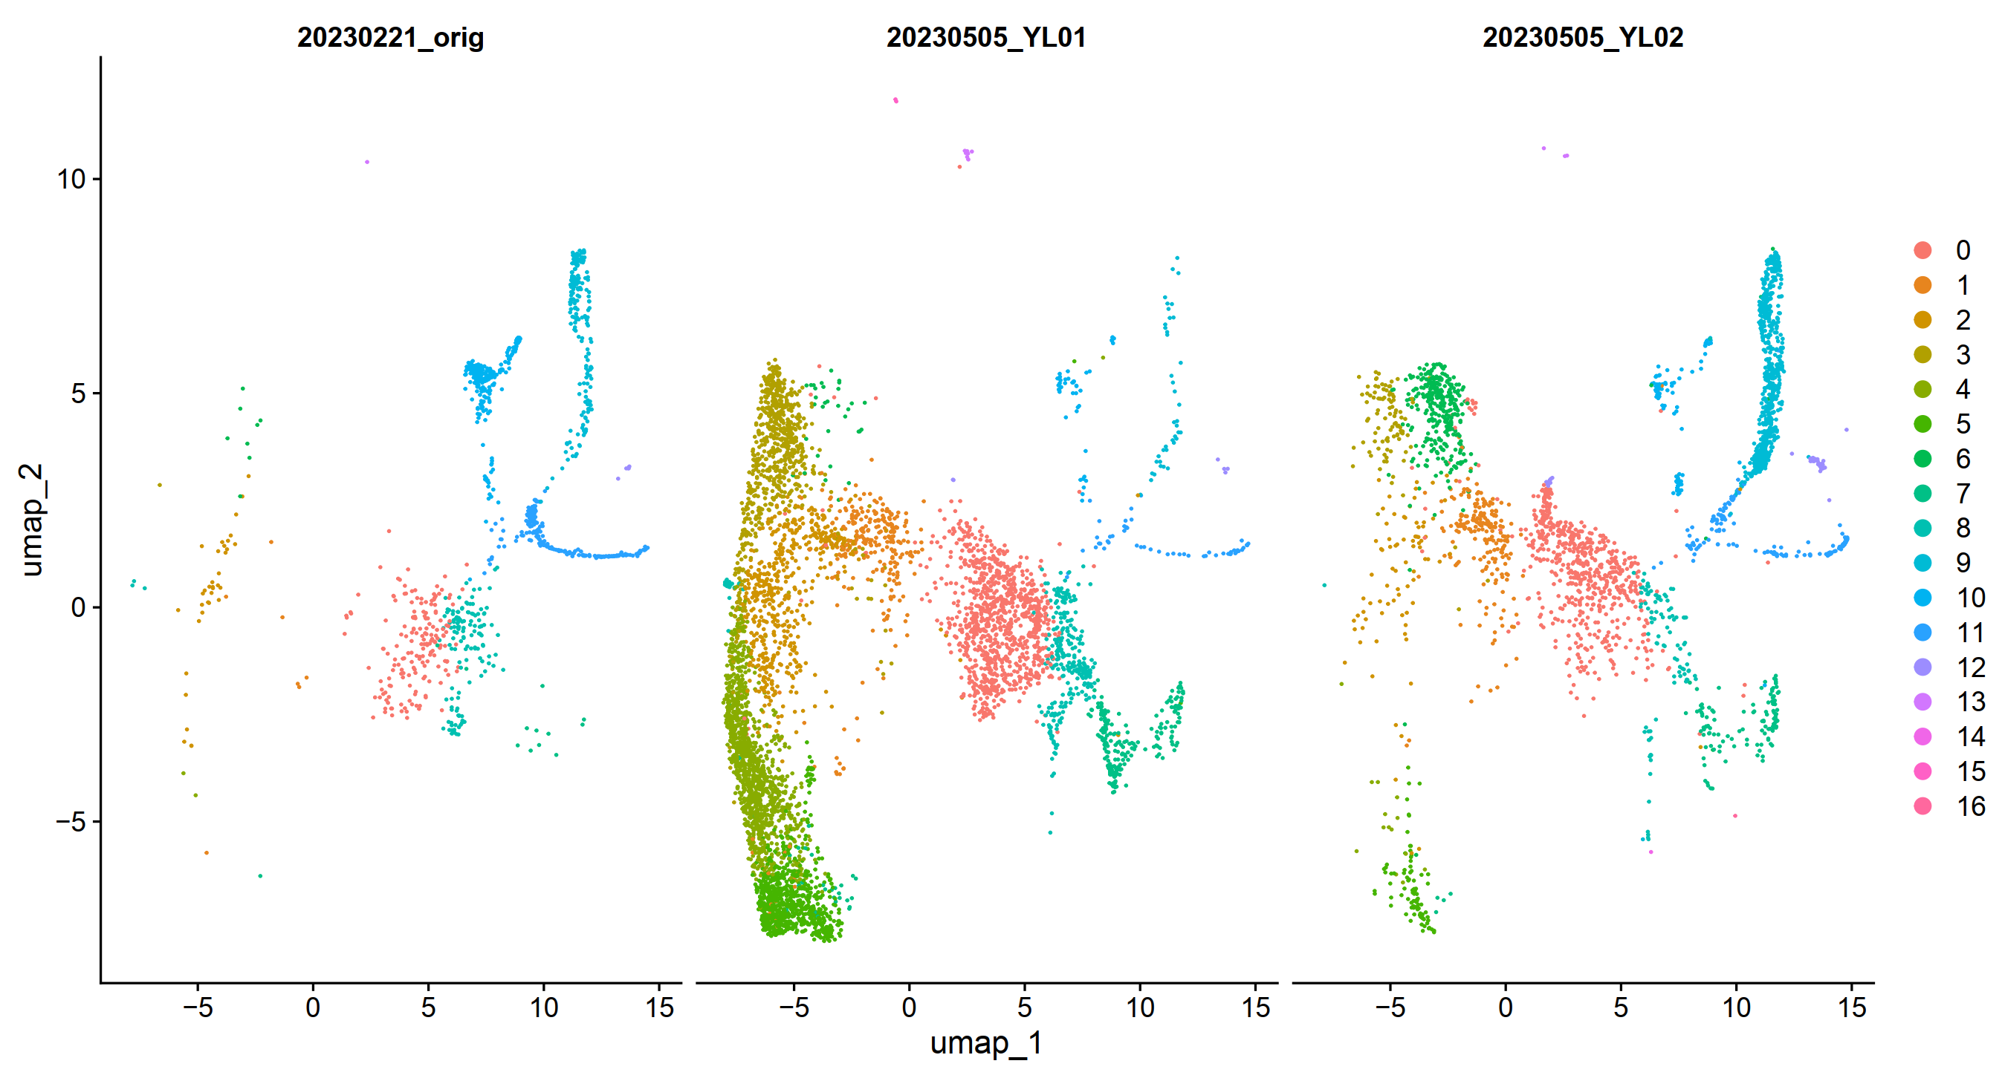
Integrated, live cells, split by sample, group by cluster

Slide 6
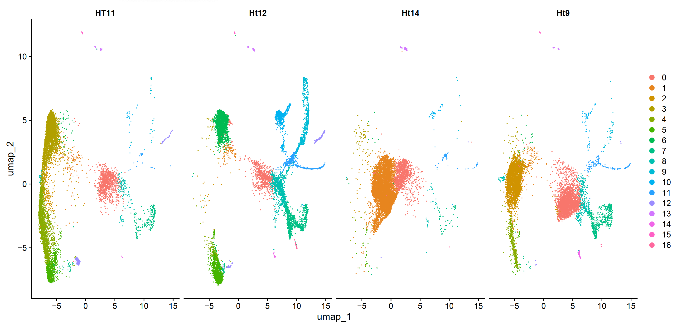
Integrated, fixed cells, split by sample, group by cluster

Slide 7
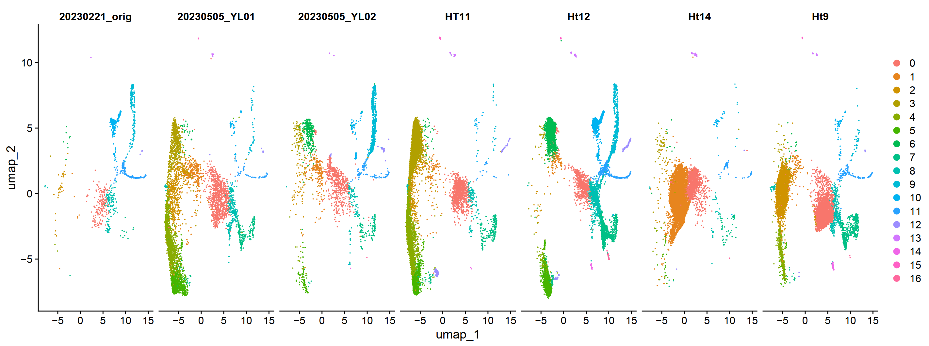
Integrated, merged sample ID, split by sample, group by cluster

Slide 8
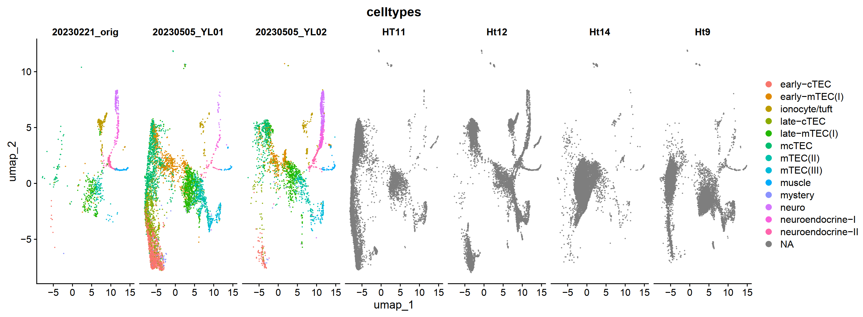
Integrated, merged sample ID, split by sample, group by cell type, label not transferred

Slide 9
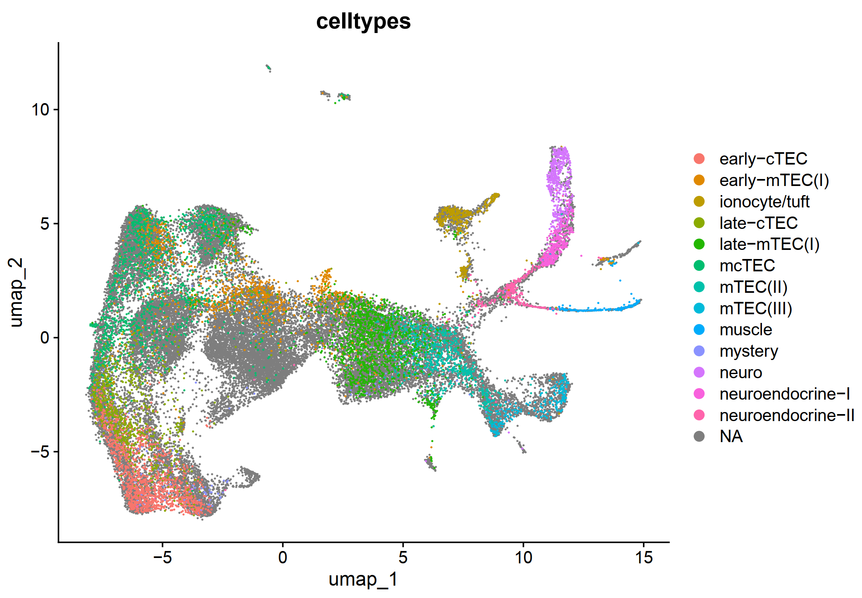
Integrated, group by cell type, label not transferred

Slide 10
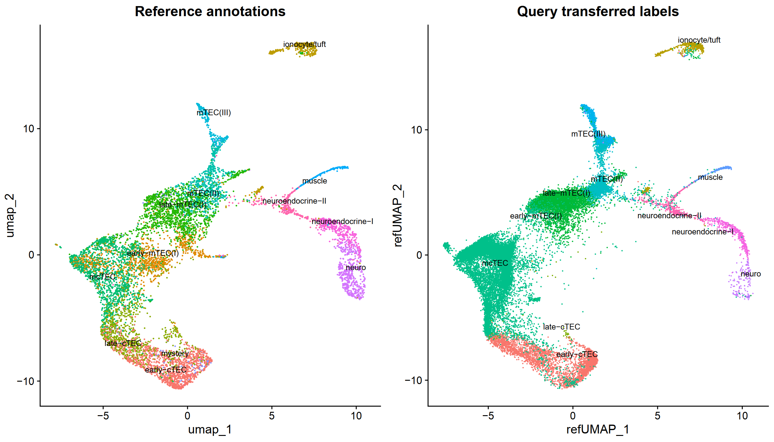
Integrated, group by cell type, label transferred, project onto reference umap

Slide 11
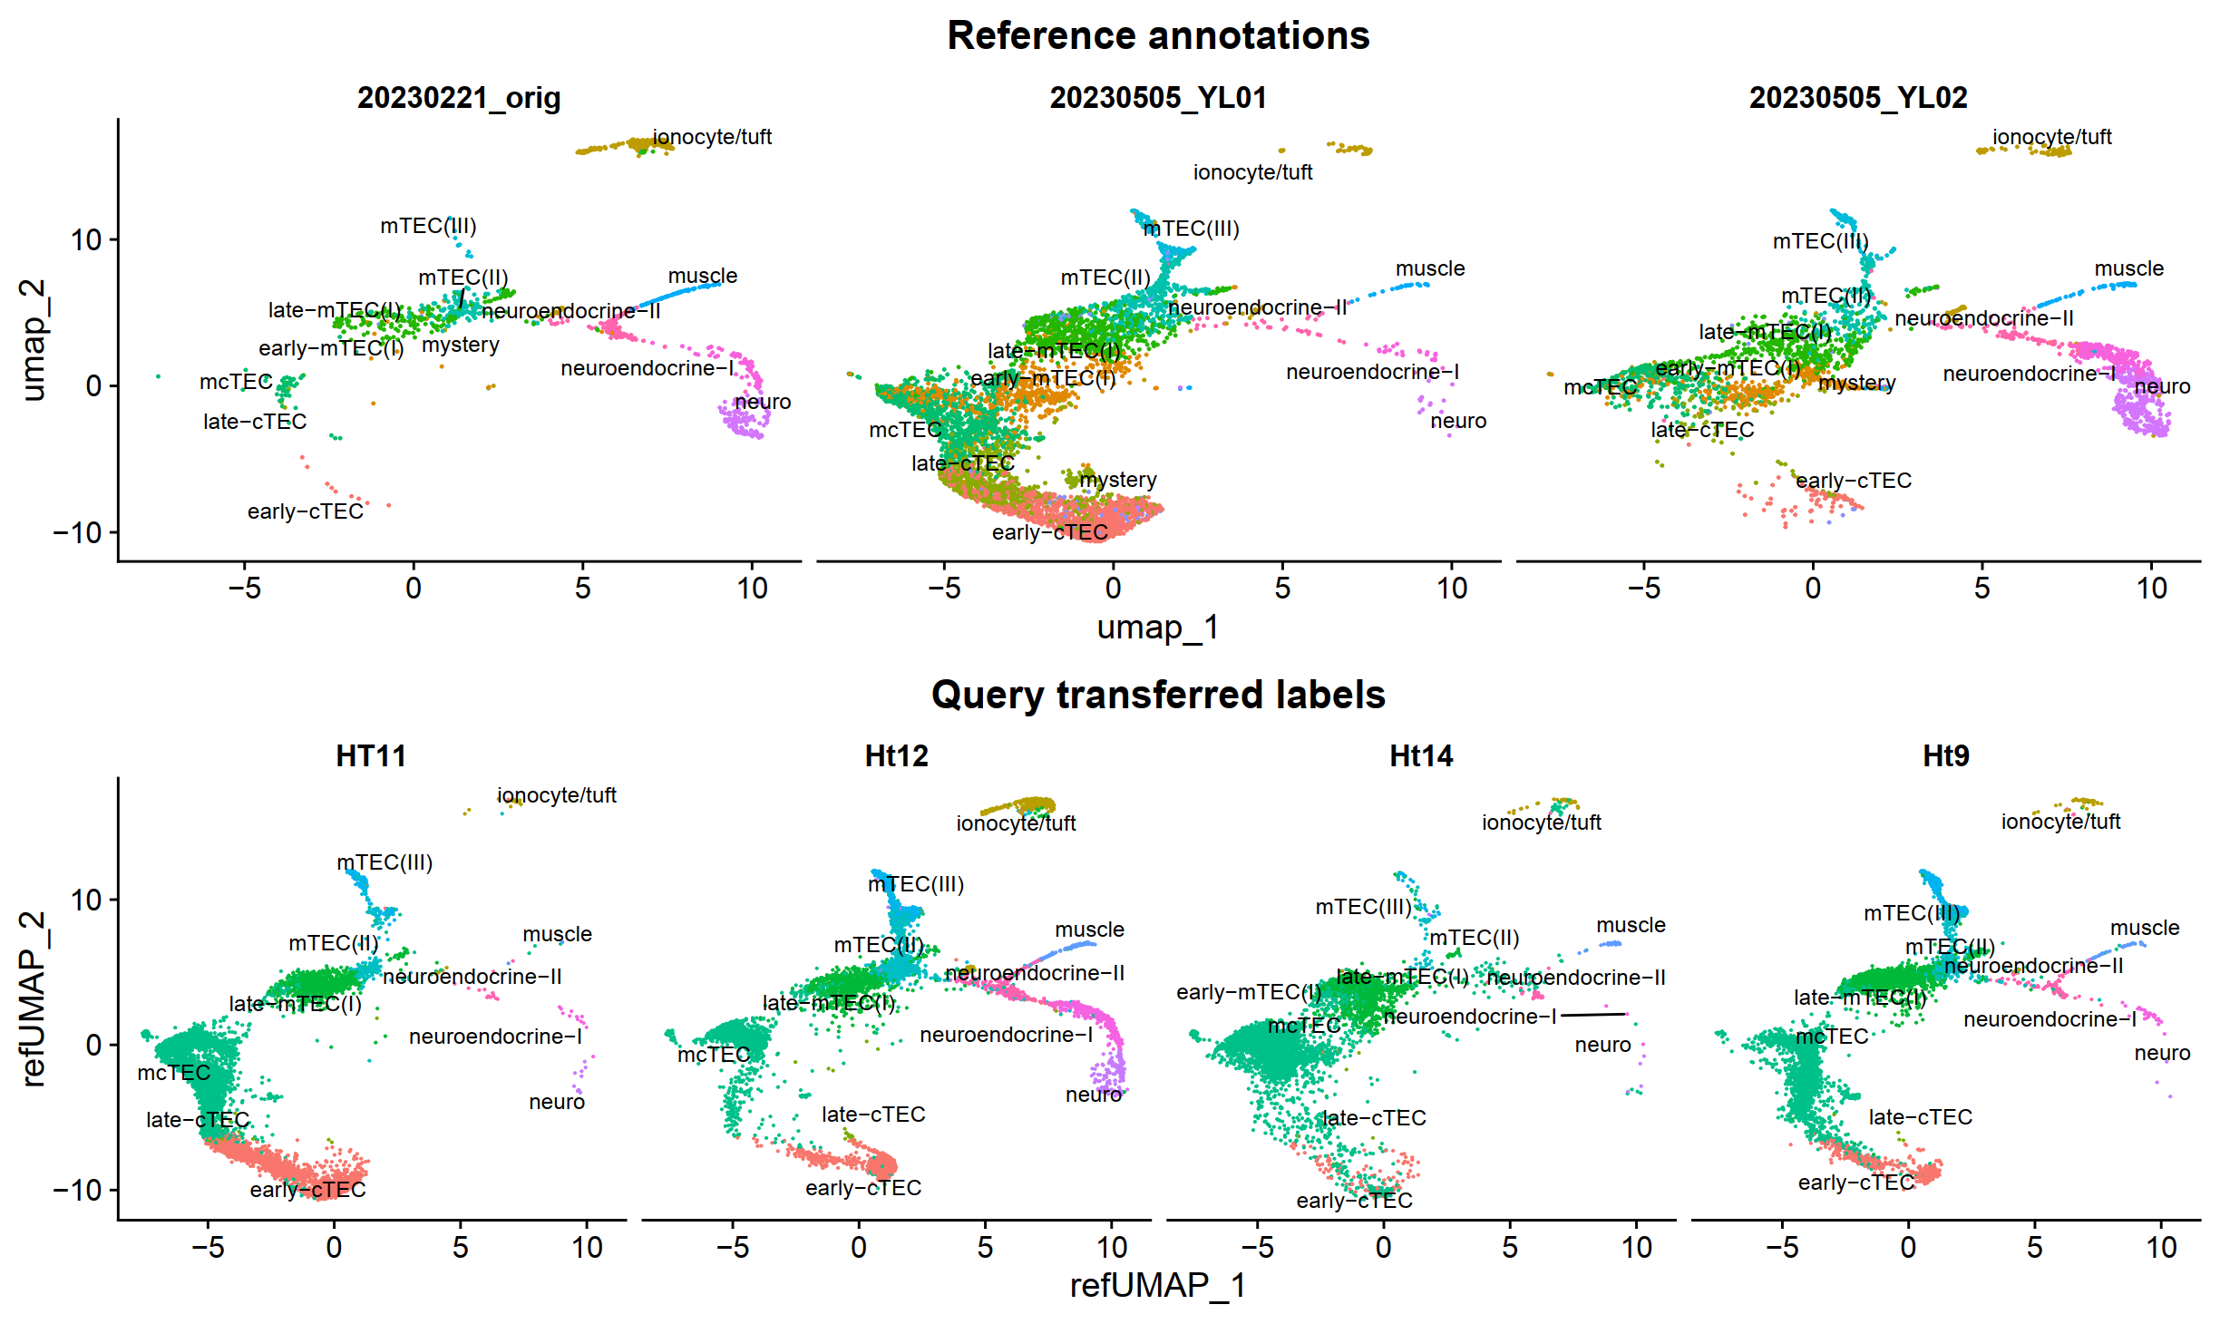
Integrated, group by cell type, label transferred, project onto reference umap

Slide 12
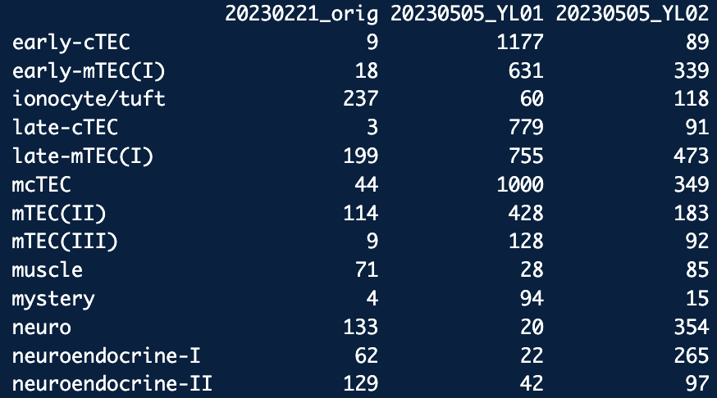
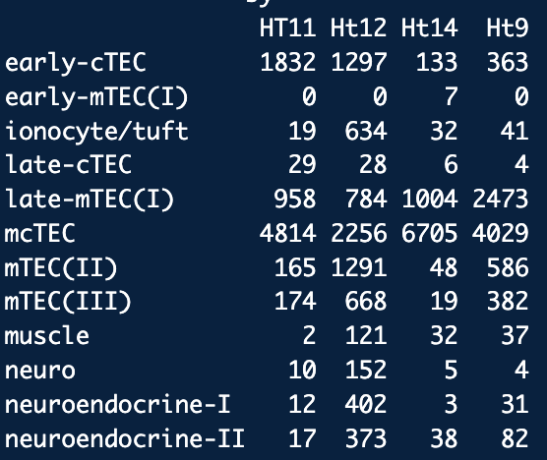
Cell Type Counts

